Slide 1
Math 141z Lesson 9: Multi-Input Functions

Slide 2
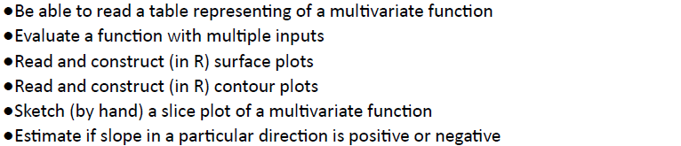
Objectives: Lesson 9

Slide 3
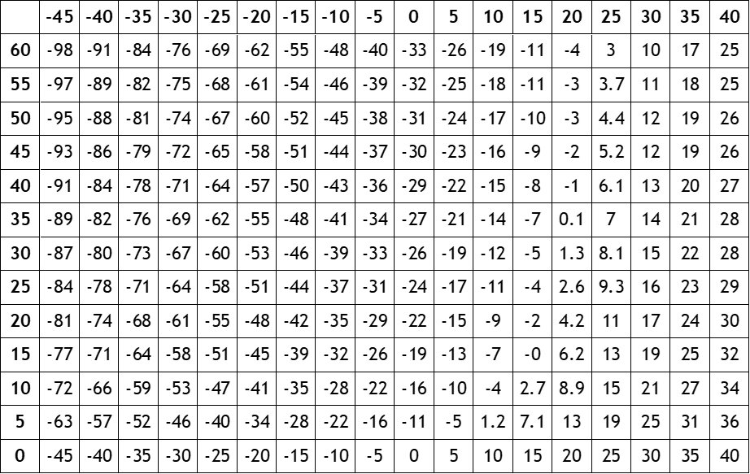
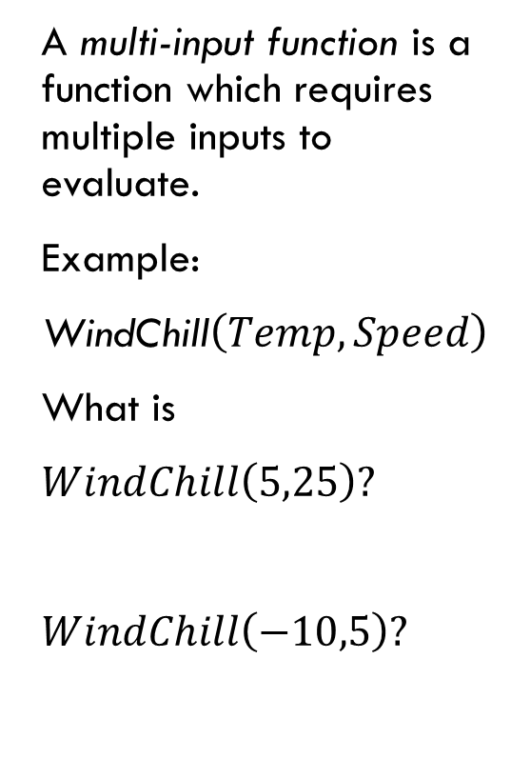
Multi-Input Functions
Temperature (F)
A multi-input function is a function which requires multiple inputs to evaluate.
Example:
WindChill$\left(Temp,Speed\right)$
What is
$WindChill\left(5,25\right)?$
$WindChill\left(−10,5\right)?$
WindSpeed (MPH)

Slide 4
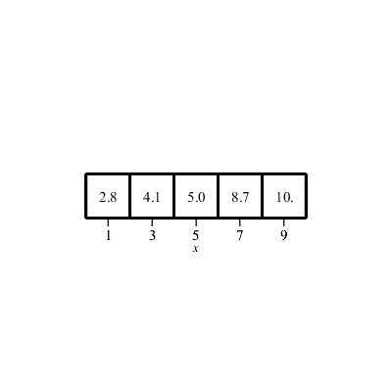
Graphing
Let’s recall how graphing functions of a single input works.

Slide 5
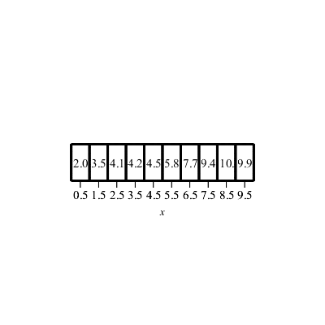
Graphing
Let’s recall how graphing functions of a single input works.

Slide 6
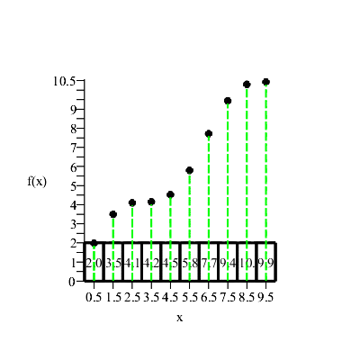
Graphing
Let’s recall how graphing functions of a single input works.

Slide 7
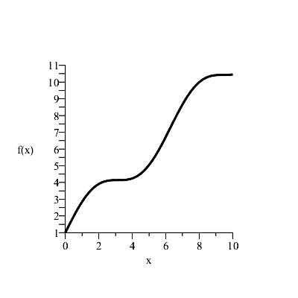
Graphing
Let’s recall how graphing functions of a single input works.

Slide 8
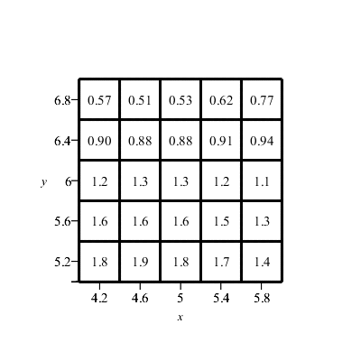

More Plots
Graphing a function of two inputs is similar.
Here is a table defining a function $f\left(x,y\right).$

Slide 9
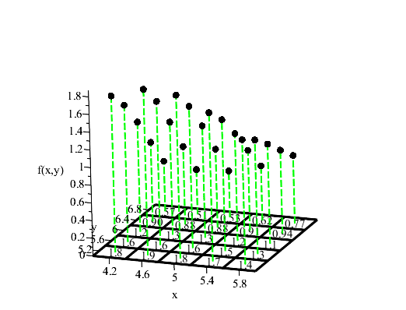
More Plots
Graphing a function of two inputs is similar.
Here is a table defining a function $f\left(x,y\right).$

Slide 10
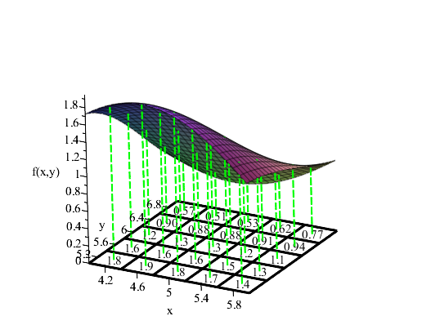
More Plots
Graphing a function of two inputs is similar.
Here is a table defining a function $f\left(x,y\right).$

Slide 11
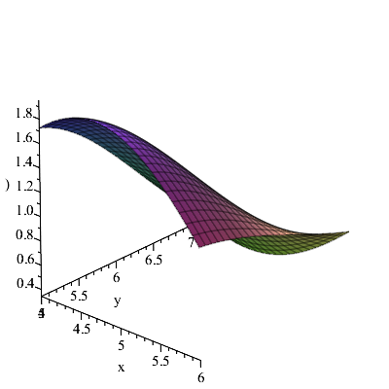
More Plots
Graphing a function of two inputs is similar.
Here is a table defining a function $f\left(x,y\right).$

Slide 12
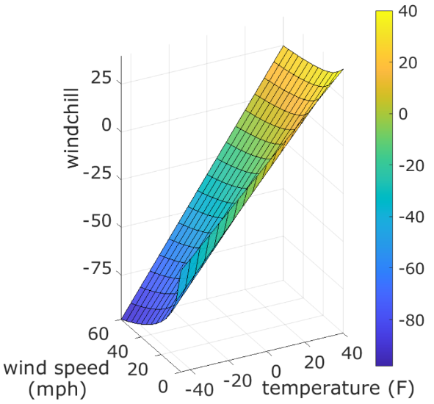
Graphing Wind Chill
WindSpeed (MPH)
Temperature (F)

Slide 13
You can make plots too
G2 <- makeFun(exp(-sqrt(x^2+y^2)) ~ x & y)
surface_with_contours(G2(x,y) ~ x + y, domain(x=c(-5,5), y=c(-3,3)))

Slide 14
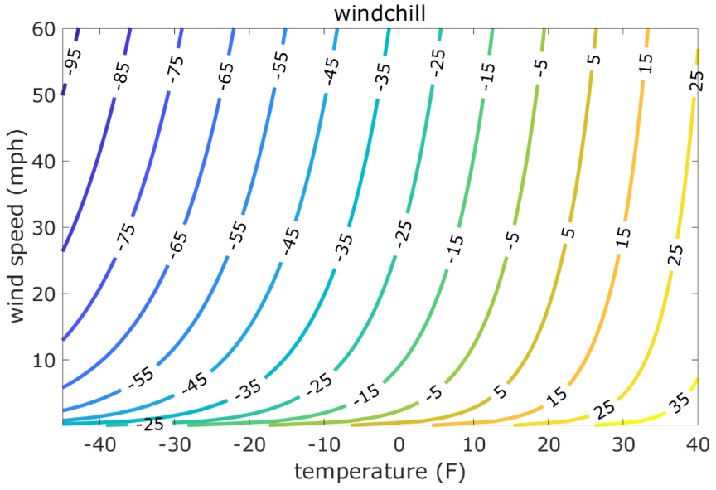

Contour Lines
A contour plot indicates function values by grouping points in the domain of $f$ that all map to a common function value.

Slide 15
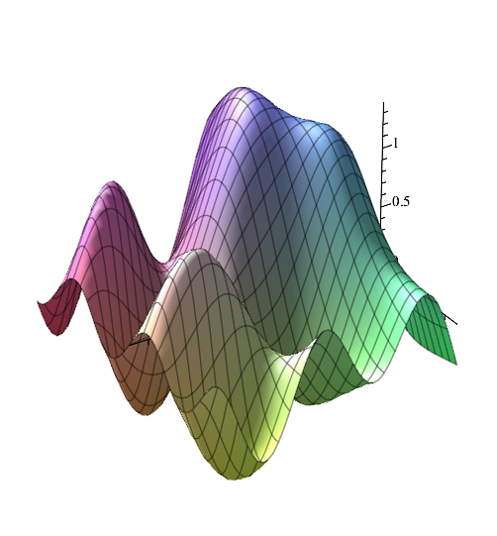
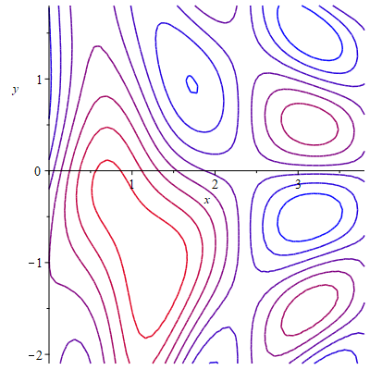
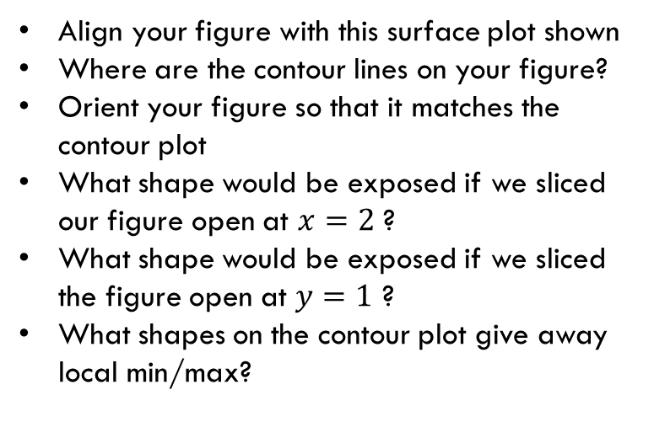
Physical Example
Align your figure with this surface plot shown
Where are the contour lines on your figure?
Orient your figure so that it matches the contour plot
What shape would be exposed if we sliced our figure open at $x=2$ ?
What shape would be exposed if we sliced the figure open at $y=1$ ?
What shapes on the contour plot give away local min/max?

Slide 16
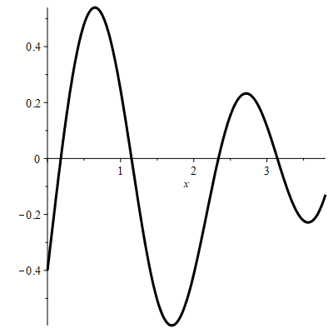
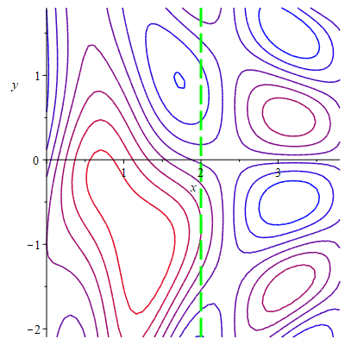
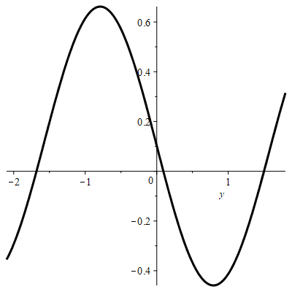
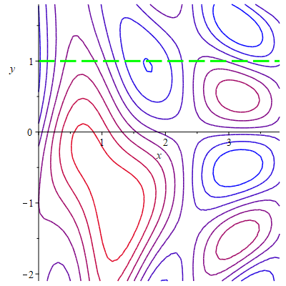
Slice Plots

Slide 17
You can plot too
G2 <- makeFun(exp(-sqrt(x^2+y^2)) ~ x & y)
slice_plot(G2(x=2,y) ~ y, domain(y=c(-3,3)))
slice_plot(G2(x,y=1) ~ x, domain(x=c(-5,5)))

Slide 18


Contours and Rate-of-Change
$$Windchill\left(temperature,40\right)$$
$$Windchill\left(0,wind speed\right)$$

Slide 19
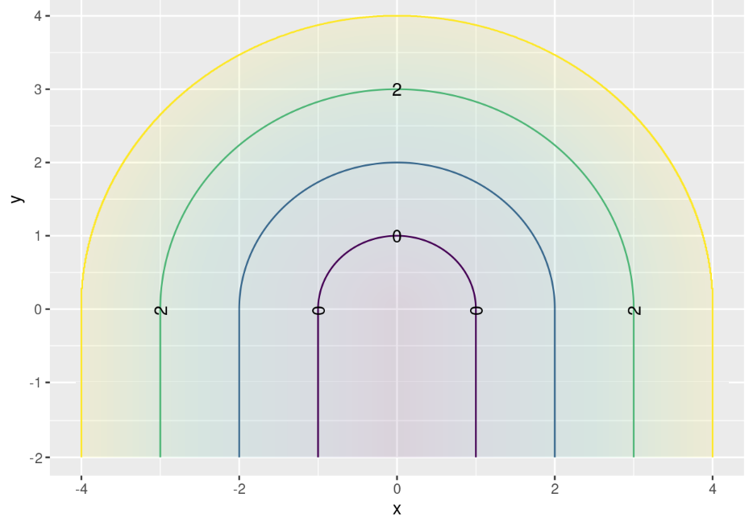
Lectinar Contours
3
2
1
0
3
2
1
1
2
3

Slide 20

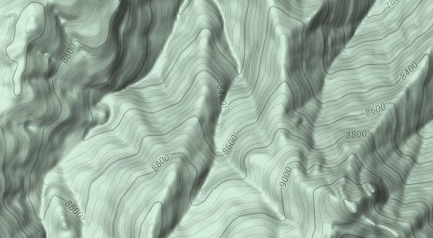
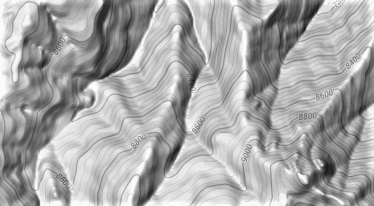
Blodgett Peak
x
x
500 ft

